Slide 1
Mini project
ADVISOR: Dr. SAMIT BISWAS

Slide 2
Indian institute of engineering science and technology , shibpur
Digital Image processing mini project
Presented by
Gourav Kumar Shaw (2020csb010)
Penugonda s m s n Rajesh (2020csb064)
Astik Gorai(2020csb038)
Babaddi Govardhan Rao Naidu (2020csb060)
Tamoghna Roy (2020csb011)
Rajput Ankit Shivsahay (2020csb081)

Slide 3
WHAT IS AN IMAGE ?
An image is defined as a two dimensional function F(X,Y),where x and y are co-ordinates .
In other words image can be defined by two dimensional array specially arranged in row and columns.
Digital image is composed of a finite number of elements.
WHAT IS DIGITAL IMAGE PROCESSING ?
Digital Image Processing is the use of a digital computer to process digital images through different algorithm
It is used to enhanced the images to get some useful information about it

Slide 4
Different Image Formats
Image Formats
JPG(.jpg, .jpeg)
PNG(.png)
TIFF(.tif)
BITMAP(.bmp)
RAW
RAW IMAGE FILES : These are unprocessed images created by a camera or scanner. Many digital camera can shoot in RAW these images are the equivalent of a digital negative meaning hat they holds a lot of image information. These images need to processed in an editor such as Adobe Photoshop or Light room.
TIFF Tagged Image File Format : This format stores image data without losing any data. It do not perform any comprerssion on images Quality images are obtained but size of the image is also large. which is good for printing

Slide 5
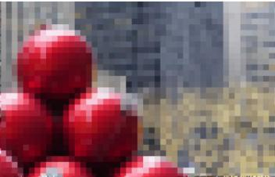
Representation of images
PIXEL: PICTURE + ELEMENT
It is the smallest part of an Image. WE can think a image is combination of millions of pixel.
If we look an image properly , we can see there are multiple small
Boxes the image contain, that boxes are pixel .

Slide 6
COMPONENTS OF PIXEL
Pixel
RED COLOR VALUE
BLUE COLOR VALUE
GREEN VALUE
Each of the color takes only one 1byte memory .
So a pixel takes total 3 bytes of memory
Since each components of the pixel takes only 1 byte of memory to represent the color.So each component can take 256 values. So total color combination is 256*256*256 =1,67,77,216

Slide 7
HOW COMPUTER STORES IMAGES?
Well Computers can only undertstand 0 or 1 .So whatever we want to store in computer it store in 0/1 format
Images are 2D so computer store each pixel value in a 2D array.
Here we have created a balck image
And print it.It shows an 2D array with 0 values.
If it is a color image then it stores corresponding color values for each pixel in a 2D array.

Slide 8
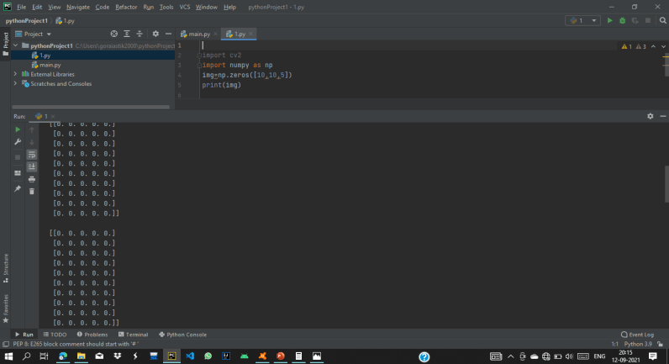
output

Slide 9
BASIC PYTHON OPENCV FUNCTION
HOW TO READ AN IMAGE?
To read the images cv2.imread() method is used. This method loads an image from the specified file. If the image cannot be read (because of missing file, improper permissions, unsupported or invalid format) then this method returns an empty matrix.

Slide 10
Syntax: cv2.imread(path, flag)
Parameters:
path: A string representing the path of the image to be read.
flag: It specifies the way in which image should be read. It’s default value is cv2.IMREAD_COLOR
Return Value: This method returns an image that is loaded from the specified file

Slide 11
HOW TO SHOW AN IMAGE? IMSHOW METHOD( )
cv2.imshow() method is used to display an image in a window. The window automatically fits to the image size.
Syntax: cv2.imshow(window_name, image)
Parameters:
window_name: A string representing the name of the window in which image to be displayed.
image: It is the image that is to be displayed.
Return Value: It doesn’t returns anything

Slide 12
CODE FOR STORE AND DISPLAY AN IMAGE
Import cv2 #importing OpenCV library
img= cv2.imread(‘image.jpg’,1) # imread method
cv2.imshow(‘new_window’,img) #imshow method
Cv2.waitKey(0) # to keep on the display

Slide 13
explanation
In imread(_)method ,we can pass an argument which decides how computer stores the image. Like if we give 1 then it will it as an color image.If we give it 0 thrn it will store it as a greyscale image.
In imshow(_) method we can pass the name of the window

Slide 14
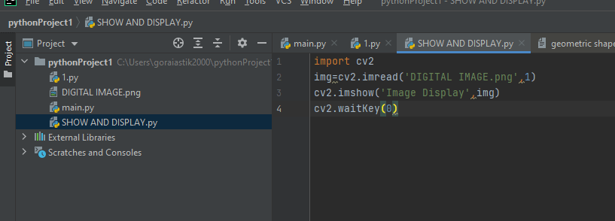
SAMPLE INPUT :

Slide 15
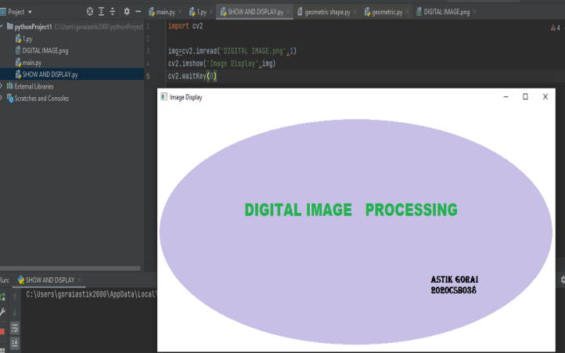
Sample output

Slide 16
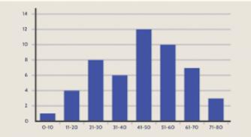
HISTOGRAM
A Histogram is a bar graph like representation of data that buckets a range of outcomes into columns along x-axis
The y-axis represents the number count or percentage of occurrences in the data for each column.

Slide 17
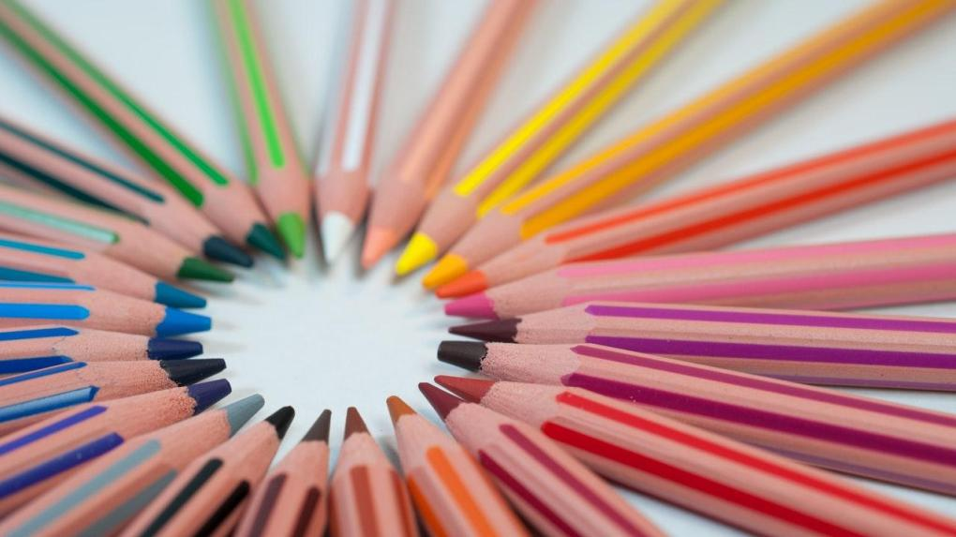
Characteristics of HISTOGRAM.

Slide 18
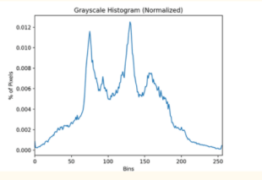
Histogram of image
The histogram of an image is a function that maps each gray level of an image to the number of times it occurs in the image.
One should note that the pixels having general, gray levels in the integer range [0,255].

Slide 19
CHARACTERSTICS OF HISTOGRAM
1. Total Number of Pixels
The total number of pixels constituting the image can be obtained by adding up the number of pixels corresponding to each gray level.
2. Image Brightness
You can get a general idea of the brightness of an image by looking at the histogram and observing the spatial distribution of the values. If the histogram values are concentrated toward the left, the image is darker . If they are concentrated toward the right, the image is lighter.
3. Contrast of a image
A histogram in which the pixel counts evenly cover a broad range of grayscale levels indicates an image with good contrast . Pixel counts that are restricted to a smaller range indicate low contrast
The total number of pixels constituting the image can be obtained by adding up the number of pixels corresponding to each gray level.

Slide 20
FINDING THE HISTOGRAM
Algorithm
First we have to create a 2D array of size equal to the dimensions of the image with all the zeros in it.
We need to traverse through the whole image and for every pixel , increase the value of corresponding gray level in the 2D array.
After we have to plot the histogram having intensity level on X-axis and number of pixels in Y- axis. We can use MatplotLib for plotting the histogram.

Slide 21
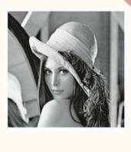
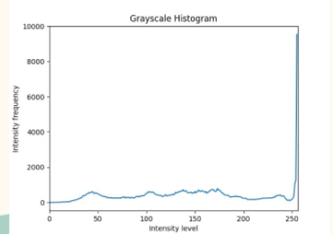
OUTPUT :

Slide 22
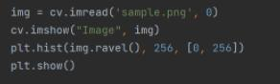
HISTOGRAM BY LIBRARY FUNCTION.
Hist Function from MatplotLib Pyplot:

Slide 23
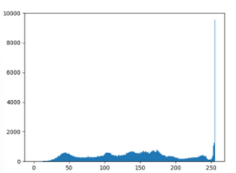
OUTPUT :

Slide 24
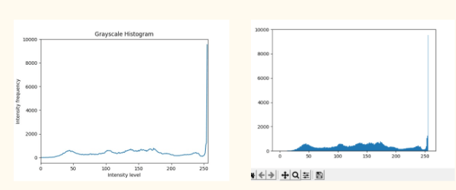
Comparing Both HISTOGRAMS

Slide 25
HISTOGRAM EQUALIZATION
Histogram Equalization is a computer image processing technique used to improve contrast in images. It accomplishes this by effectively spreading out the most frequent intensity values, i.e. stretching out the intensity range of the image. This method usually increases the global contrast of images when its usable data is represented by close contrast values. This allows for areas of lower local contrast to gain a higher contrast.

Slide 26
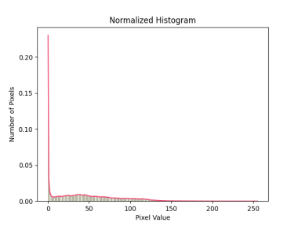
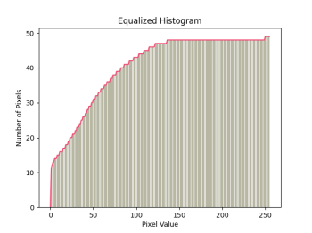
Contd….
Histogram equalization is commonly used in order to enhance the contrast of the image . By this technique we spread the histogram through out the gray levels as much as possible
This technique can’t guarantee to always improve the quality of the image.
By spreading pixel values to all gray levels the quality of the image sometime increases

Slide 27
ALGORITHM FOR HISTOGRAM EQUALIZATION
STEP 1
FORM ACTUAL HISTOGRAM OF THE IMAGE
STEP 2
FIND CUMULATIVE DISTRIBUTION FUNCTION FOR EACH GRAYLEVEL THAT IS: REPEAT UNTILL I= 256:histogram[i]= histogram[i]+ histogram[i-1]
STEP 3
THEN FIND OUT THE PROBABILITY DISTRIBUTION FUNCTION ,BY DIVIDING THE EACH GRAYLEVEL TO THE TOTAL NO OF PIXEL
STEP 4
THEN MULTIPLY EACH VALUE TO ITS MAXIMUM GRAY VALUE THAT IS 255
STEP 5
THEN ROUND OF THE FIGURE TO ITS NEAREST INTEGER VALUE

Slide 28
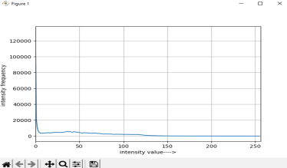
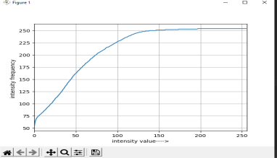
SAMPLE INPUT OUTPUT
WITHOUT EQUALIZATION
WITH EQUALIZATION

Slide 29
IMAGE CONTRAST STRETCHING(IMAGE ENHANCEMENT)
Contrast stretching or Normalization is one operation applied on images, which improves the contrast of the image so that the details present in the image can be clearly seen.
Contrast stretching is applied directly on the image by modifying each pixel present in the image - that is by applying point operations rather then using a kernel.
By not using a kernel means each pixel value is not determined using the values of a neighborhood pixels. The intensity value of the pixel is modified using a normalization formula.
ALGORITHM:
STEP 1
MAKE THE EQUALIZED HISTOGRAM
STEP 2
TRAVERSE THE WHOLE IMAGE AND UPDATE EACH PIXEL TO NEW PIXEL VALUE

Slide 30
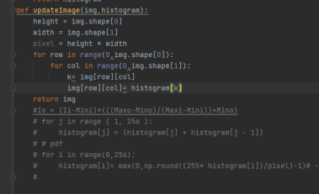
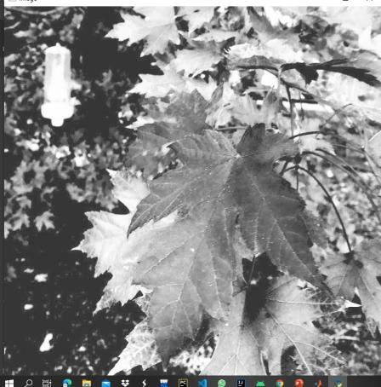
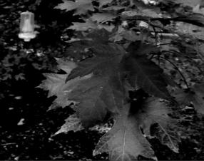
SAMPLE INPUT OUTPUT FOR IMAGE ENHANCEMENT
OUTPUT
C0DE
INPUT IMAGE

Slide 31
IMAGE SEGMENTATION:
Image segmentation is the process of the partition the image into different set of pixels .
DIFFERENT TYPES OF IMAGE SEGMENTATION METHOD
Thresholding
Clustering
Edge based segmentation
Artificial Neural Network based segmentation
Partial Differential Equation Based Segmentation

Slide 32
IMAGE THRESOLDING:
Thresholding is a very popular segmentation technique used for separating objects rom its background
The process involving comparing each pixel of the image to a given pixel called threshold
Depending upon the threshold value we divide the image into two types
→pixel having value less then threshold value
→ pixel having higher value then threshold
?
NOW WE HAVE TO CHOOSE A THRESHOLD VALUE . HOW CAN WE TAKE THE THRESHOLD VALUE

Slide 33
ALGORITHM FOR THRESHOLD TECHNIQUE
STEP 1
Process the input image
STEP 2
Obtain the image Histogram
STEP 3
Compute the threshold value
STEP 4
Replace Image pixels into white in those regions ,where saturation is greater then the threshold value and black in opposite cases.

Slide 34
CHOOSING THE THRESHOLD VALUE
Depending on the process of choosing threshold value we can divide the threshold technique into mainly two type
→ Simple Thresholding
→Adaptive Thresholding
Simple Thresholding:
In simple thresholding process we give a predefined pixel value as threshold value . It is for the whole image .That is the given threshold value act as a global threshold value.
Based on this threshold value we divide the images into two regions one group having pixel values higher then the
Predefined threshold value and another have lower then the thresold value

Slide 35
DIFFERENT TYPES OF SIMPLE THRESOLDING
SIMPLE THRESOLDING
BINARY THRESOLD
INVERTED BINARY THRESOLD
TRUNCATE THRESOLDING
_,th1= cv2.threshold(src,threshold valu,max value of grey level, threshold types)
THRESOLD TO ZERO
This is a predefined function in opencv. we can use it to Try this various types of threshold technique
THRESOLD TO ZERO INVERSE

Slide 36
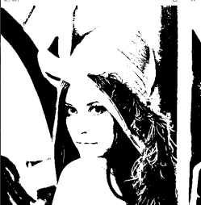
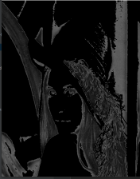
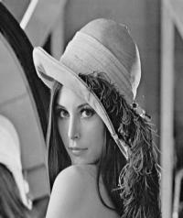
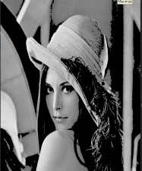
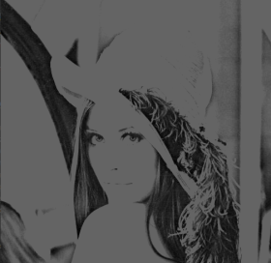
VISUALIZATION OF DIFFERENT THRESOLD TYPES:
Thresh to binary
Thresh to zero inverse
THRESH TO
ZERO
Thresh truncate
PROBLEM: WE HAVE TO GIVE A PREDEFINED VALUE

Slide 37
OTSU THRESOLDING
AUTOMATIC GLOBAL THRESOLDING
The algorithm returns a single intensity threshold that it separates the pixels into two classes foreground and background
It involves iterating through all possible threshold values and calculating a measure of spreads for the pixel levels each sides of the threshold .
Them aim is to find out the threshold value where the sum of foreground and background spreads as minimum

Slide 38
STEP 1
Process the input image and Obtain the image Histogram
STEP 2
Choose a threshold value from starting index of the histogram
Divide the histogram into two part one for foreground and another for background
STEP 4
For each foreground and background find out weight ,mean and variance for each gray level.
STEP 3
STEP 5
Find out the within class variance by vb*wb + vf*wf
Repeat step 2 3 4 for each gray level
→ Take the minimum with in class variable and return the corresponding threshold value
STEP 6

Slide 39
ADAPTIVE THRESOLDING
Thresholding is the simplest way to segment objects from a background. If that background is relatively uniform, then we can use a global threshold value to binarize the image by pixel-intensity. If there’s large variation in the background intensity, however, adaptive thresholding also known as local or dynamic thresholding may produce better results.
•Adaptive thresholding is the method where the threshold value is calculated for smaller regions and therefore, there will be different threshold values for different regions.

Slide 40
OPENCVFUNCTIONS USED
•Opencvfunctionusedforadaptivethresholdingaregivenbytwofunctionsthatis..
•Adaptive_thresh_mean_c−thresholdvalueisthemeanofneighborhoodarea.
•Adaptive_thresh_gaussian_c−thresholdvalueistheweightedsumofneighborhoodvalueswhereweightsareagaussianwindow.

Slide 41
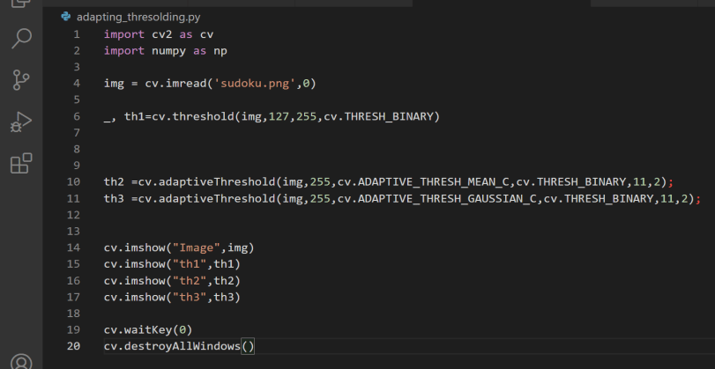
CODE TO SHOW ADAPTIVE THRESHOLDING

Slide 42
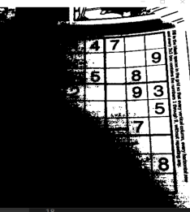
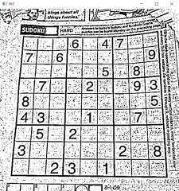
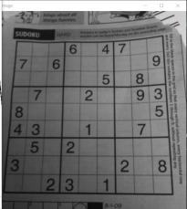
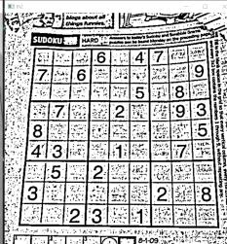
OUTPUT OF OUR CODE
Simple thresholding
Gaussian thresholding
Original image
Adaptive thresholding

Slide 43
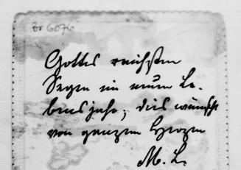
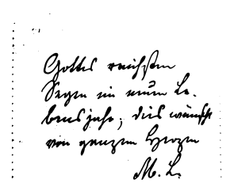
RESULTS OF SIMPLE THRESHOLDING

Slide 44
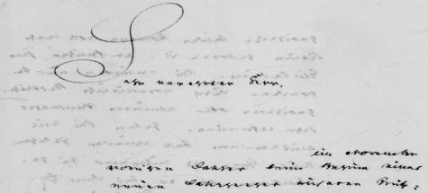
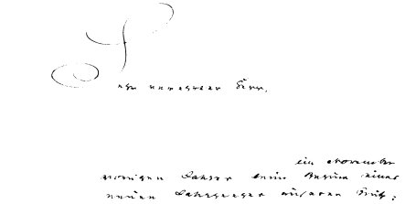

Slide 45
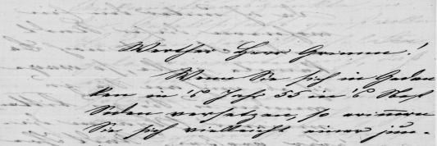
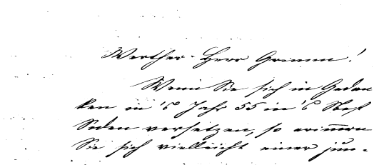

Slide 46
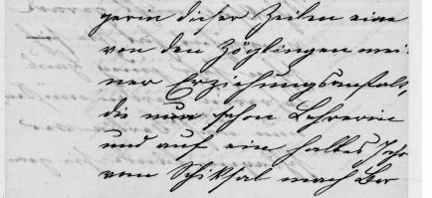
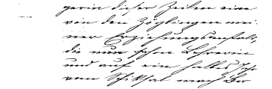
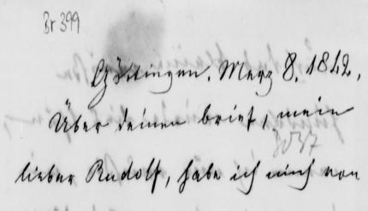
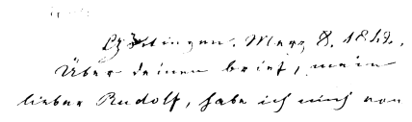

Slide 47
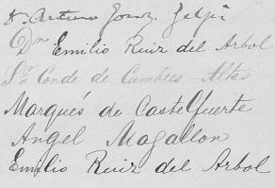
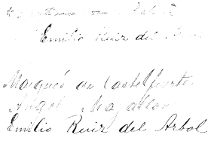
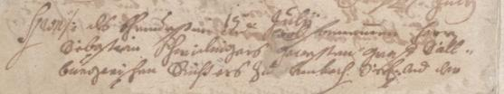
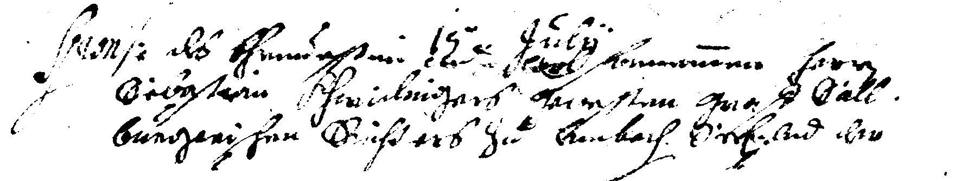

Slide 48
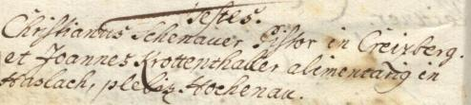
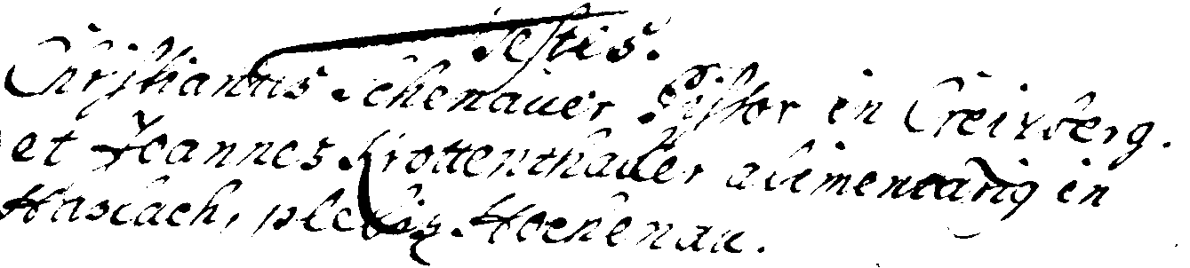
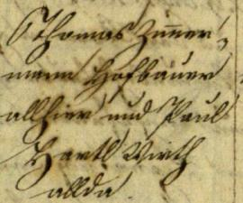
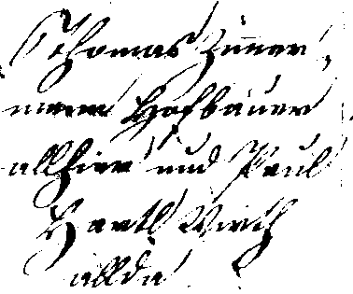

Slide 49
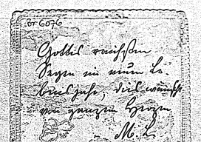
RESULTS OF ADAPTIVE THRESHOLDING

Slide 50
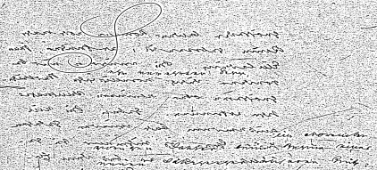
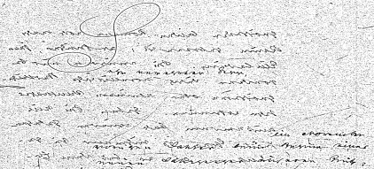

Slide 51



Slide 52





Slide 53





Slide 54





Slide 55

RESULTS OF OTSU THRESHOLDING

Slide 56


Slide 57


Slide 58



Slide 59



Slide 60



Slide 61
IMAGE FILTERING
•Image filtering is the process ofmodifying an image by changing its shades or color of the pixel. It is also used to increase brightness and contrast.
•Types are follows
Image averaging is a digital image processing technique that is often employed to enhance video images that have been corrupted by random noise. The algorithm operates by computing an average or arithmetic mean of the intensity values for each pixel position in a set of captured images from the same scene or viewfield.
Median filter also known as salt papperfilter
•Median filtering is a nonlinear method used to remove noise fromimages. It is widely used as it is very effective at removing noise while preserving edges. It is particularly effective at removing ‘salt and pepper’ type noise.

Slide 62
IMAGE FILTERING CONTINUE..
Gaussian filter
Gaussian filtering is more effective at smoothing images. It hasits basis in the human visual perception system. It has been found that neurons create a similar filter when processing visual images..
Bilateral filter
A bilateral filter is anon-linear, edge-preserving, and noise-reducing smoothing filter for images. It replaces the intensity of each pixel with a weighted average of intensity values from nearby pixels.

Slide 63

CODE TO SHOW FILTERING

Slide 64

OUTPUT OF OUR CODE FOR LENA IMAGE

Slide 65

OUTPUT FOR SALTPAPPERIMAGES

Slide 66
GOOGLE COLAB NOTEBOOK LINK
Link for Notebook :
https://colab.research.google.com/drive/1zGaJyei-no8fyfFJlVnc_PPf7rbaTNKp?usp=sharing

Slide 67
Document Image analysis
The objective of Document Image analysis is to recognize the text & graphics components in image of documents & to extract intended information from them.
OCR (optical character recognition) is the use of technology to distinguish printed or handwritten text characters inside digital images of physical documents, such as a scanned paper document.
The basic process of OCR involves examining the text of a document and translating the characters into code that can be used for data processing. OCR is sometimes also referred to as text recognition.

Slide 68
DENOISING IMAGES FOR BETTER OCR
When working with documents generated by a computer, screenshots, or essentially any piece of text that has never touched a printer and then scanned, OCR becomes far easier.
That all changes once a piece of text is printed and scanned. From there, OCR becomes much more challenging.
To overcome this issue we need to denoise images . We are going to implement denoising of images using Machine Learning. That will increase the quality of document images and can be helpful for text recognisition and for many applications.

Slide 69
ALGORITHM
Our denoising algorithm hinges on training an RFR to accept a noisy image and automatically predict the output pixel values.
These algorithms work by applying a 5 x 5 window that slides from left-to-right and top-to-bottom, one pixel at a time across both the noisy image (i.e., the image we want to pre-process automatically and cleanup) and the target output image

Slide 70
WHAT WE DO
At each sliding window stop, we extract The 5 x 5region of the noisy input image. We then flatten the 5 x 5 region into a 25-d list and treat it like a feature vector.
The same 5 x 5 region of the cleaned image, but this time we only take the center (x, y)- coordinate, denoted by the location (2, 2).
Given the 25-d (dimensional) feature vector from the noisy input image, this single pixel value is what we want our RFR to predict

Slide 71

Example
This 25-d vector is our feature vector upon which our RFR will be trained. However, we still need to define the target output value of the RFR. Our regression model should accept the input 25-d vector and output the cleaned, denoised pixel.

Slide 72
Given our trainX variable (our raw pixel intensities), we want to predict the corresponding cleaned/denoised pixel value in trainY .
We will train our RFR in this manner, ultimately leading to a model that can accept a noisy document input and automatically denoise it by examining local 5 x 5regions and then predicting the center (cleaned) pixel value.
Ex: trainX = [[247 227 242 253 237 244 228 225 212 219 223 218 252 222 221 242 244 228 240 230 217 233 237 243 252]] trainY = [[1]]

Slide 73
CREATING BLUR AND THRESHOLD HELPER FUNCTION
To help our RFR predict background (i.e., noisy) from foreground (i.e., text) pixels, we need to define a helper function that will pre-process our images before we train the model and make predictions with it.

Slide 74

First, we take our input image, blur it (top-left), and then subtract the blurred image from the input image (topright). We do this step to approximate the foreground of the image since, by nature, blurring will blur focused features and reveal more of the “structural” components of the image.

Slide 75
IMPLEMENTING THE FEATURE EXTRACTION SCRIPT
As the name suggests, this script is responsible for creating our 5 x5 - 2d feature vectors from the noisy image and then extracting the target (i.e., cleaned) pixel value from the corresponding gold standard image. We’ll save these features to disk in CSV format and then train a Random Forest Regression model on them

Slide 76



Slide 77
Slide a 5 x 5 window from left-to-right and top-to-bottom across the trainImage and cleanImage. At each sliding window stop, we extract the 5 x 5 ROI of the training image and clean image. We grab the width and height of the trainROI , and if either the width or height is not five pixels (due to us being on the borders of the image), we throw out the ROI (because we are only concerned with 5 x 5 regions). Next, we construct our feature vectors and save the row to our CSV file.

Slide 78
IMPLEMENTING OUR DENOISING TRAINING SCRIPT
Now that our features.csv file has been generated, we can move on to the training script. This script is responsible for loading our features.csv file and training an RFR to accept a 5 x 5 region of a noisy image and then predict the cleaned center pixel value.

Slide 79
We start looping over all lines of our CSV file . For each row, we extract both the target and pixel values. We then update both our features and targets lists, respectively.
After training is complete, we compute the root-mean-square error (RMSE) to measure how good a job we’ve done at predicting cleaned, denoised images. The lower the error value, the better the job we’ve done.

Slide 80


Slide 81


Slide 82
IMAGE BINARIZATION BY ML TECHNIQUE

Slide 83
What is image binarization?
Binarization is the process of converting a pixel image to a binary image
Image binarization is the process of taking a grayscale image and converting it to black-and-white, essentially reducing the information contained within the image from 256 shades of gray to 2: black and white, a binary image

Slide 84
USING K-MEANS CLUSTERING
We will consider the image binarization problem as a binary classification problem where each of the pixels in the image have to be classified as one of those 2 classes only. The classes are the “Background” & the “Foreground”. This type of classification problem can be tackled by seeing these 2 classes as clusters in an image where the cluster will be classified as one of the two classes.

Slide 85

STEPS :

Slide 86
Color Conversion
This step is needed to convert the color space to RGB if you are using any other color space and we also normalize the pixel values so, that all the pixel values are in the range 0-1.

Slide 87
Contrast Enhancement
This step is needed to overcome the problems like uneven illumination and gradients in the image. We use modified histogram equalization for contrast enhancement for this step. This minimizes the problems of over enhancement, saturation artifacts and change in mean brightness.

Slide 88


RESULTS :
Original Image :
Binarized Image :

Slide 89


89
RESULT II :
Original Image :
Binarized Image :

Slide 90


90
90
RESULT III :
Original Image :
Binarized Image :

Slide 91
THE END… THANK YOU

